Slide 1
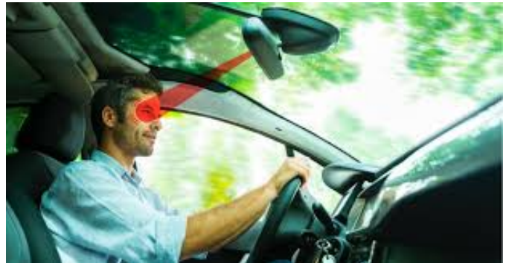
Driver Drowsiness Detection using Deep Learning

Slide 2
Team Members
UNDER THE SUPERVISION OF
PROF KIRAN KUMAR PATTANAIK
1. 2021 IMT 010 AMARNATH SHARMA C
2. 2021 IMT 051 KHANDGONDA NITIN
3. 2021 IMT 053 KORAMPALLI JAYA SATWIK
4. 2021 IMT 083 SABHAVATH YASHWANTH

Slide 3
Introduction
1. Around the world, there are about 2,600 accidents happening every day, which means someone dies in a car crash every four hours. Researchers say that about 20% of deadly car crashes are because the driver was drowsy
2 Our project is all about using advanced technology, like deep learn?ing, to make driving safer. We develped special system that can recognize signs of drowsiness in drivers, like when their eyes start to close or they seem less attentive.
3. When the system notices these signs, it’ll sound an alarm to wake up the driver or remind them to take a break. By doing this, we hope to prevent accidents and make the roads a much safer place for everyonee.
4 .We used tranfering learning technique and inception V3 as base model for training data

Slide 4
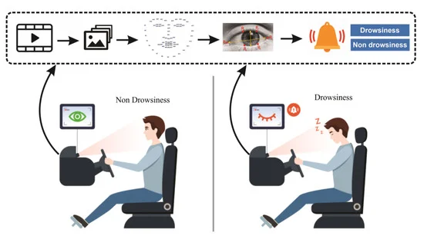
Algorithm

Slide 5
ASSUMPTIONS
Vehicle is moving
No obstruction between camera and eye
Reliable lighting is present
Camera should be turned on
Minimum environmental disturbances
Better Camera Quality

Slide 6
Phases
Data Collection and Preprocessing
Model Training
ROI Extraction
Model Prediction

Slide 7
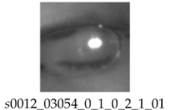
Dataset
Dataset is containing 37 person Images comprised of total
84,898 images
Each and every image is associated with unique ID
Example:

Slide 8
Data Preprocessing
Every image is having unique ID in which 4th ID indicates weather image is
containing open eye or close eye
We classified open eye images and close eye images depending on that ID
Later we kept 80% of open eye images and 80% of close eye images into
training data
And then remaining 20% of open eye images and 20% of close eye images
into testing data

Slide 9
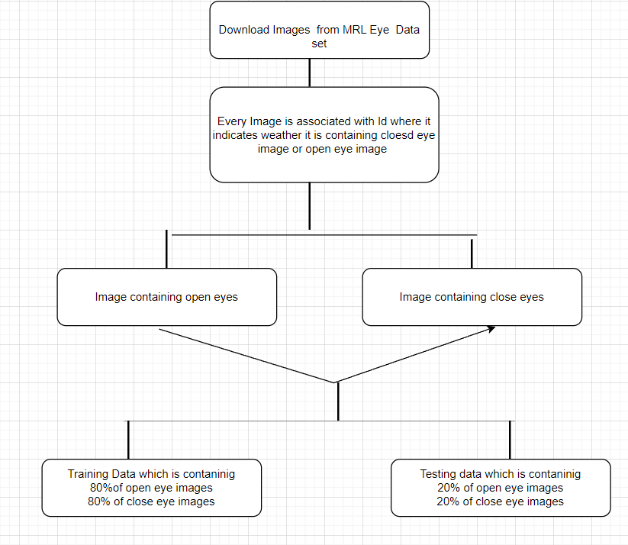
Data Preprocessing

Slide 10
Model Training
Convolutional Neural Network :
CNN is a foundational deep learning architecture used for image classification, object detection and computer vision tasks.
It It can take image has input and learn the hierarchies of features from an image. It comprises multiple layers, including convolutional layers, pooling layers, and fully connected layers
In general ANN depends on Multiplication however CNN depends on mathematical operation called convolution instead.
It involves the process of sliding filters across an image, and finding the features of every corresponding sub-matrix.
This architecture uses activation functions such as ReLU, Softmax, Sigmoid etc.. in order to introduce non-linearity to the network, allowing it to learn more complex patterns and relationship in the data.

Slide 11
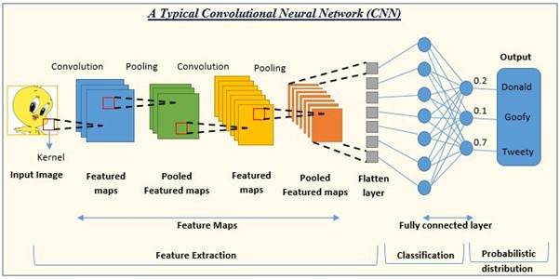
Pooling Layer : The main purpose of this layer is to reduce the size of image and also preserve information. This operation includes two methods called Max Pooling and Avg Pooling.
Flattening : It is a layer where the output of previous layers is Flattened into a single array or vector.
Fully connected layer : It’s a dense
network of neurons used to classify
the image after convolution and
pooling. They merge high level
traits discovered in earlier layers
and contribute to the final decision
-making process.

Slide 12
InceptionV3 Model :
InceptionV3 is a single convolutional neural network (CNN) architecture that is developed by Google. It incorporates multiple convolutional layers and innovative designs such as the Inception modules.
The Inception module consists of multiple parallel convolutional pathways, each processing the input data in a different way.
It is a pretrained version of the network that is trained on more than a million images from the ImageNet database. It contains a total of 48 deep convolutional layers.
Both InceptionV3 and standard CNN architectures operate on RGB images, but they employ different strategies for feature extraction. InceptionV3 uses multiple filters of various sizes across all color channels simultaneously within its Inception modules, while standard CNNs typically apply a single filter independently to each color channel.

Slide 13
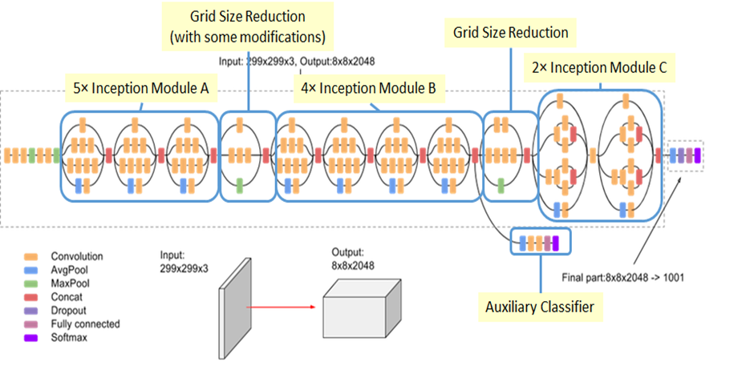
InceptionV3 Architecture :

Slide 14
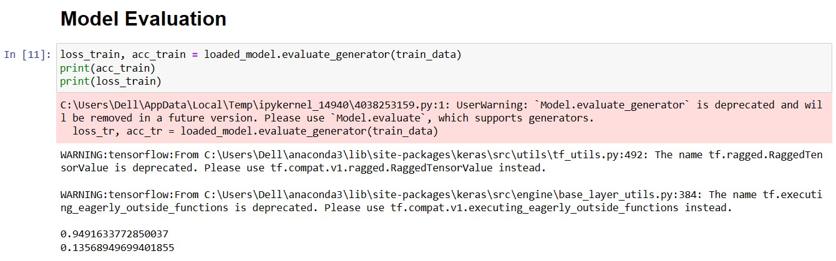
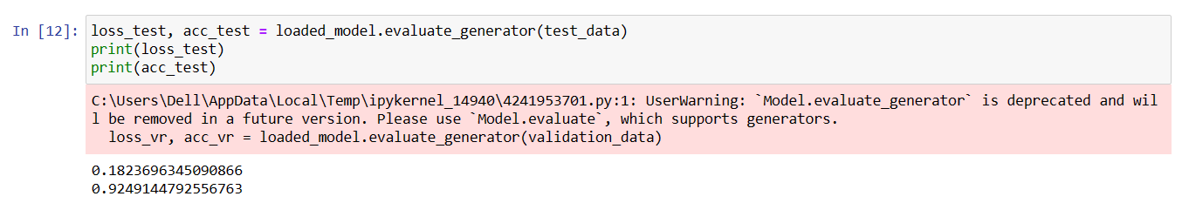
Results of InceptionV3 Model :
Training Accuracy :
Test Accuracy :

Slide 15
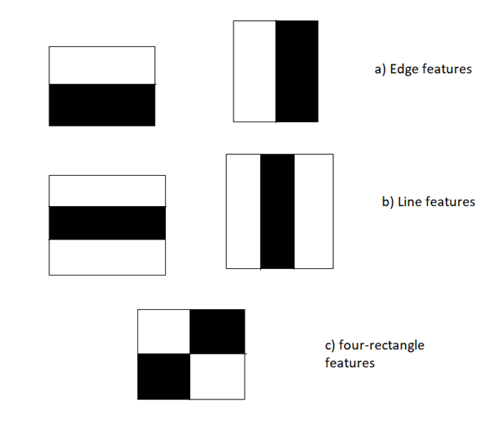
ROI EXTRACTION USING HAAR CASCADE
haar cascade is a ML based object detection technique which is popular for detecting faces. The Haar Cascade algorithm is trained using a large dataset of positive and negative examples.
How it works
The algorithm uses a set of predefined features called Haar-like features. These features are simple rectangular patterns that are calculated over the image at different scales and positions.

Slide 16
How it works
the algorithm slides window of fixed size across the image then it calculates delta
delta = Intensity of white region - intensity of black region
Goal is to chose a feature for each location in order to maximise delta
So features are location dependent that is each location may use different feature
features also have different sizes
The trained model consists of a cascade of classifiers, each of which consists of several stages.
Each stage consists of a set of weak classifiers, typically based on a simple machine learning algorithm like decision trees or boosted classifiers.
These weak classifiers sequentially filter out regions of the image that are unlikely to contain the object, allowing subsequent stages to focus on more promising regions.

Slide 17
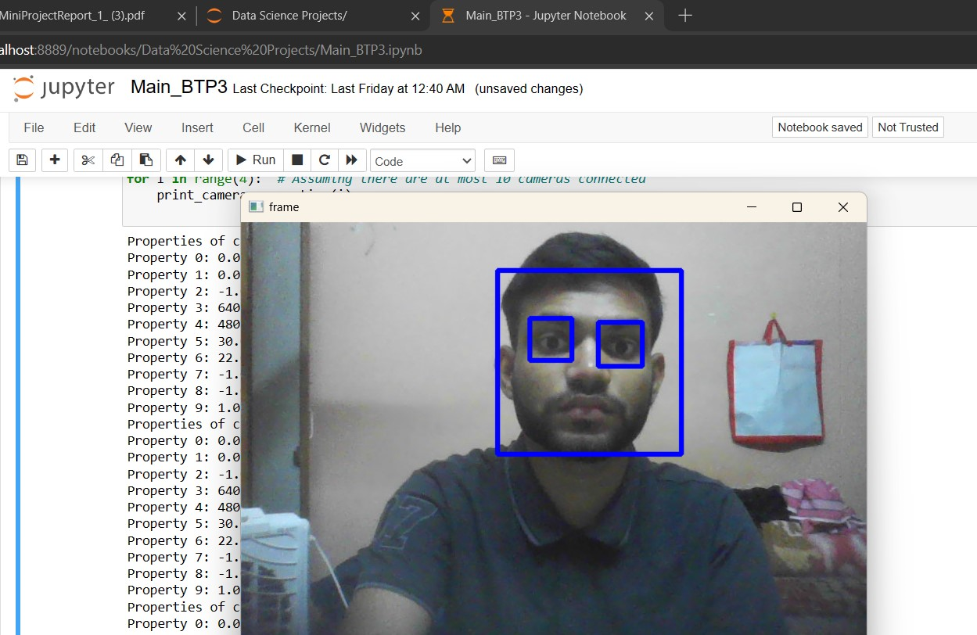
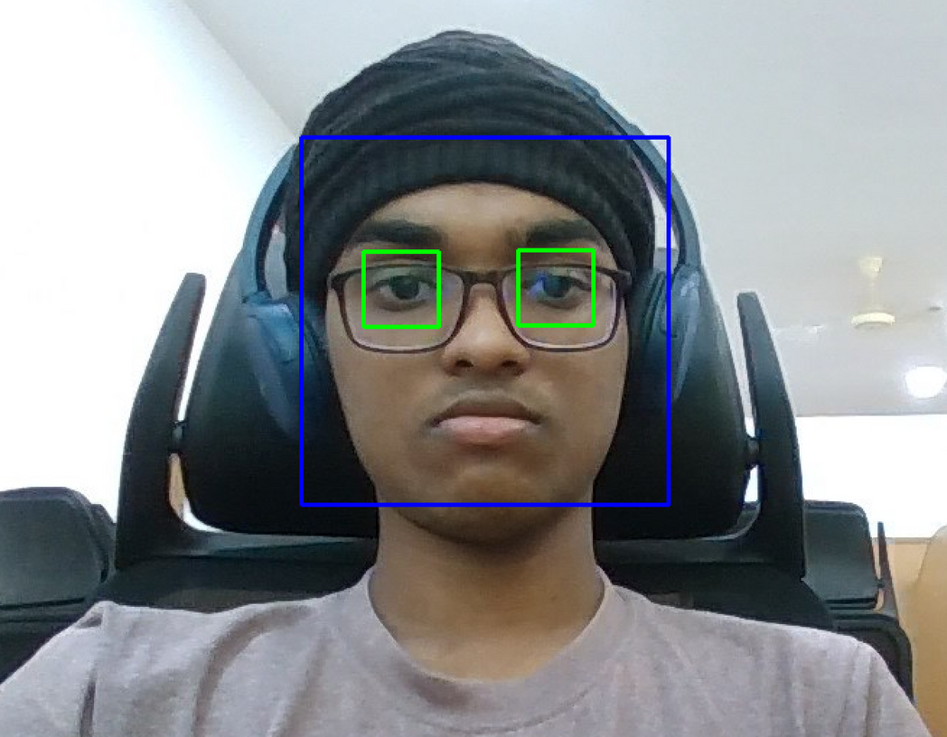
Output of haar cascade classifier

Slide 18
Overview of the main algorithm
Capture video
extract frame
extract ROI(eyes)
Rescale Image
MODEL
Open Eyes
Close Eyes
next frame
SCORE is updated

Slide 19
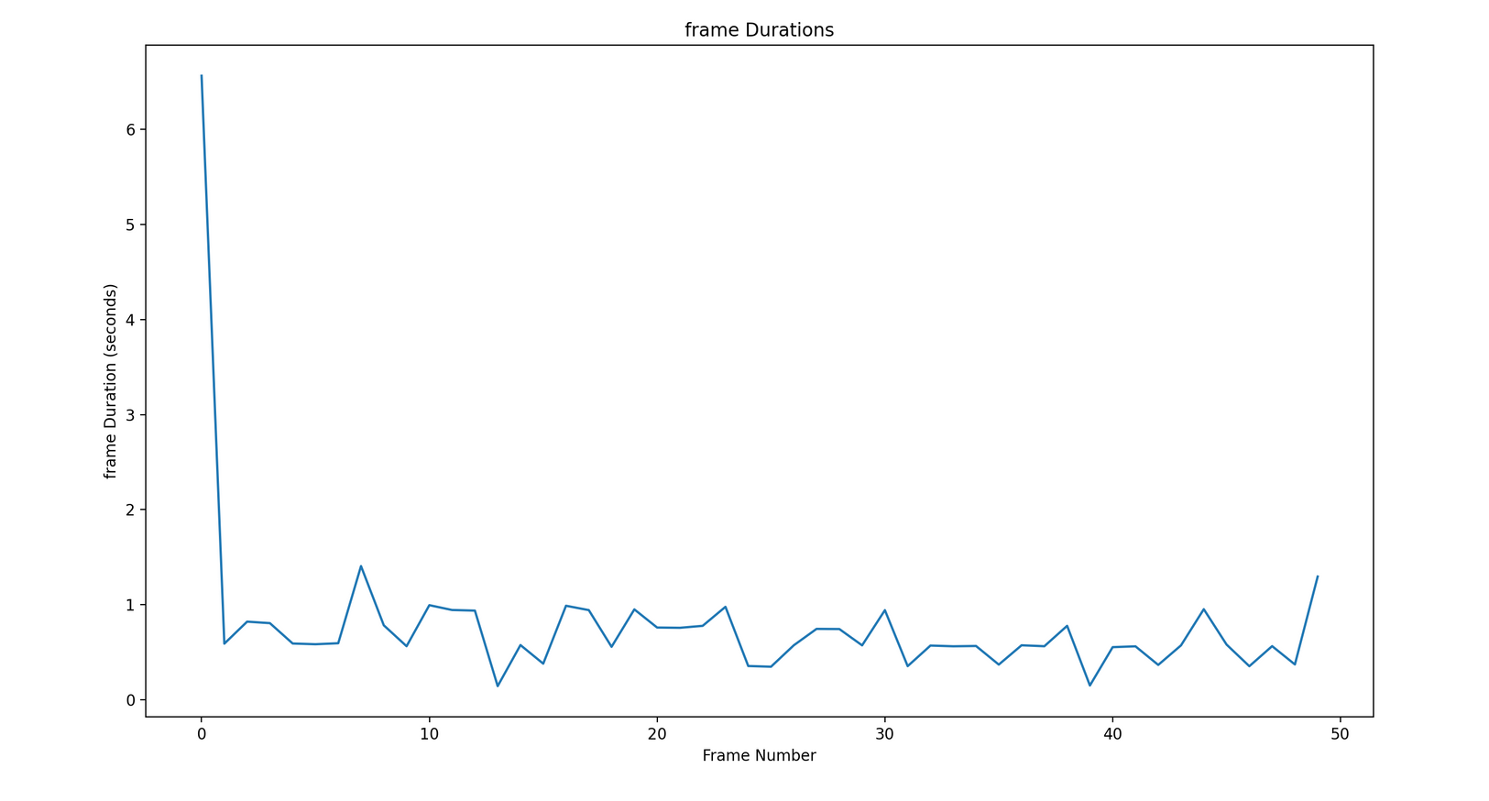
FRAME DURATION
In this case frame duration is defined as the time taken to process a frame
Each iteration captures one frame and processes it
First iteration captures first(zeroth) frame
The below graph is for first 50 iterations (50 frames ) of a video

Slide 20
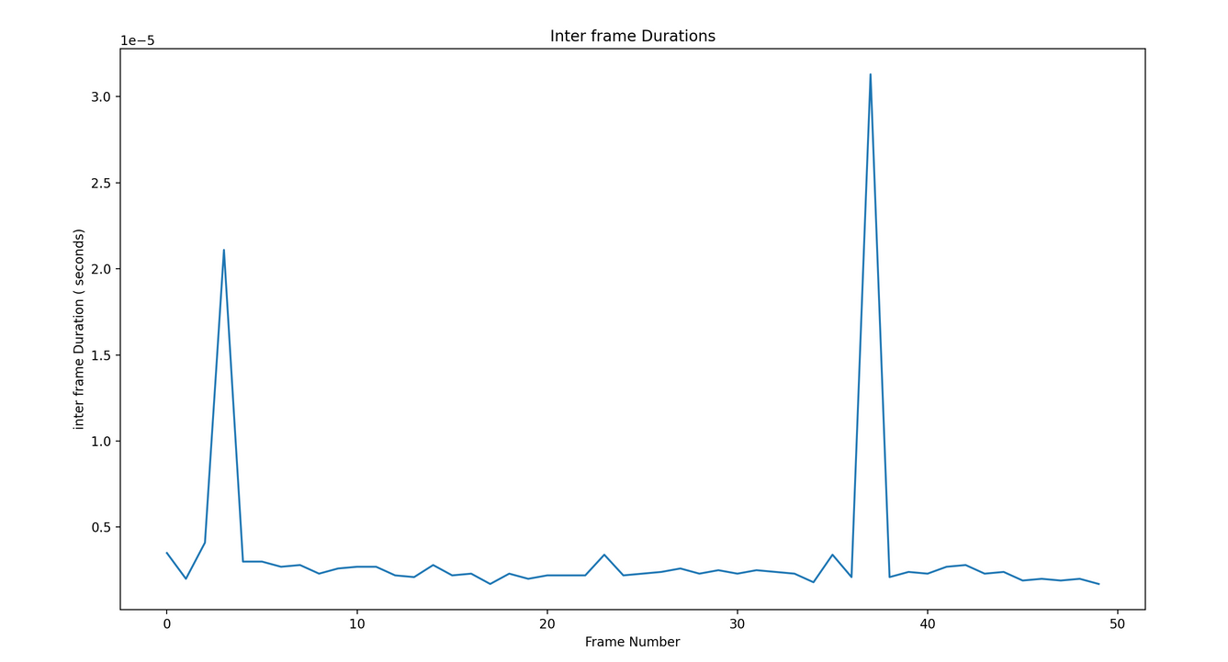
INTERFRAME DURATION
Its defined as the difference between start time of current frame and end time of previous frame.
Since we are processing each frame within one iteration this definition comes down to start time of current iteration and end time of previous iteration.
This is negligible as the time frame between 2 iterations is close to 0 in python.
Graph of inter frame duration in 10^-5 seconds for 50 frames.

Slide 21
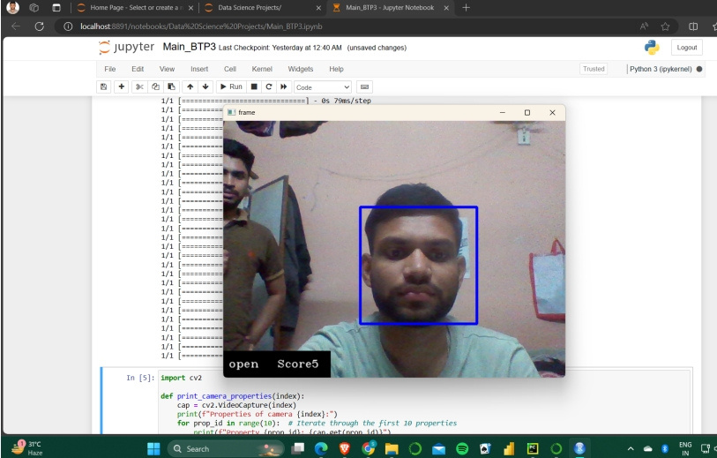
RESULTS:
Practical working
If the drowsiness score calculated from our analysis falls below a threshold of 10, the alarm will not be triggered

Slide 22
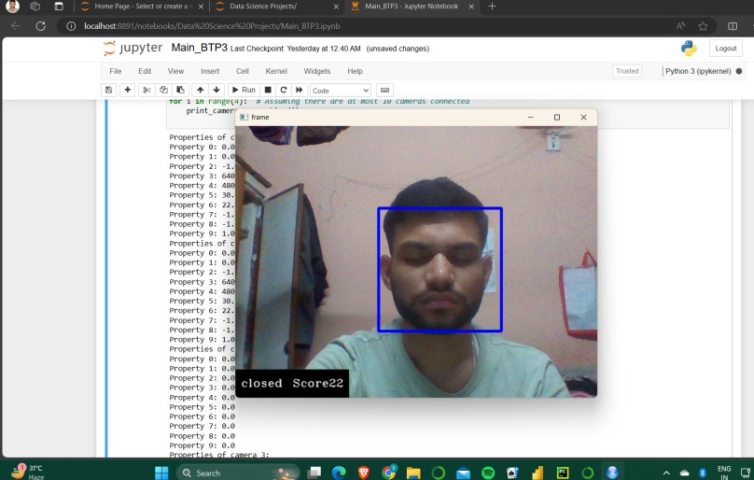
RESULTS:
Practical working
If the drowsiness score calculated from our analysis is above a threshold of 10, the alarm will be triggered

Slide 23
FUTURE SCOPE:
1.Improving efficiency of the application:
• Model optimization:
1. Optimise parameters using cost functions and gradient descent.
2. Implement model pruning( to remove redundant connections in between
layers)
• Hardware acceleration: More number of CPUs, GPUs, threads etc increase the performance considerably
• Diverse input data: In order to make the model robust and efficient a large labelled dataset can be used
2. Integration with Hardware device for breaking:
Automatic breaking system can be integrated with this application so that whenever alarm rings brakes are automatically applied. Automatic emergency braking (AEB) requires sensors, Brake actuators, CPU(for processing sensor data) and a power supply

Slide 24
CONCLUSION :
In our driver drowsiness detection project, the initial step crucially involves extracting frames from the camera feed using the OpenCV library, a powerful tool in computer vision.
This enables us to capture discrete snapshots of the road scene, which are then fed into our detection model for analysis. our primary objective is to detect signs of drowsiness in drivers. As we sequentially extract frames from the continuous camera feed, we facilitate real-time monitoring of the driver’s state.
These frames serve as snapshots of the driver’s behavior over time, allowing us to analyze their facial expressions, eye movements, and other indicators of drowsiness. Following frame extraction, the subsequent step involves leveraging deep learning techniques to recognize and localize potential signs of drowsiness within the visual content of each frame in real-time.
By employing this methodology, we aim to create a system capable of alerting drivers or authorities when signs of drowsiness are detected, thereby enhancing road safety

Slide 25
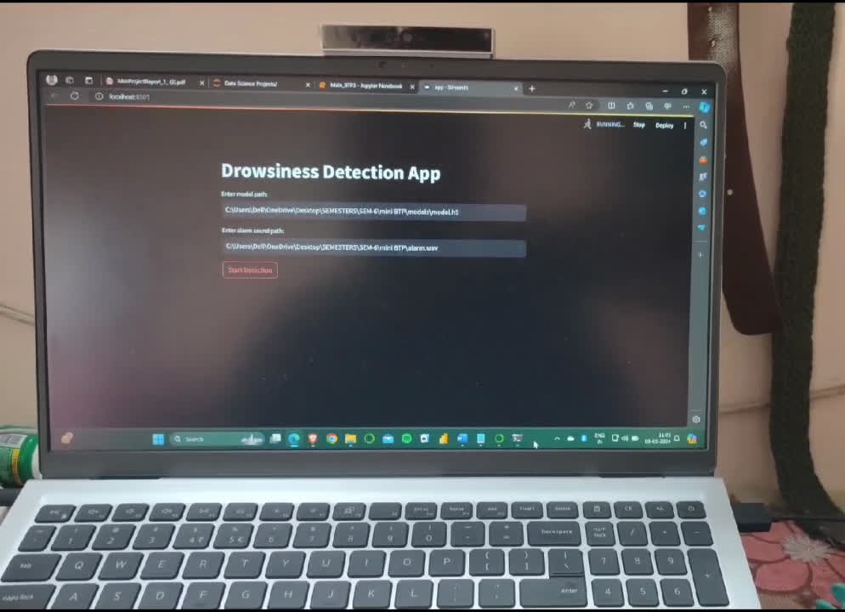
Demo

Slide 26
THANK YOU!

